Slide 1
Get me out of here: Determining optimal policies
Seminar: Cyber Physical systems
Advisor: Christian Pek

Slide 2
Outline
Background and Problem Statement
Fundamentals of Dynamic Programming
Solving the Dynamic Programming equations
Related work and use cases in robot motion planning

Slide 3




Background and Problem Statement
Notes:
Starting with the background
Show a problem everybody might know from childhood
Coming to problem statement
Solving it mathematical

Slide 4

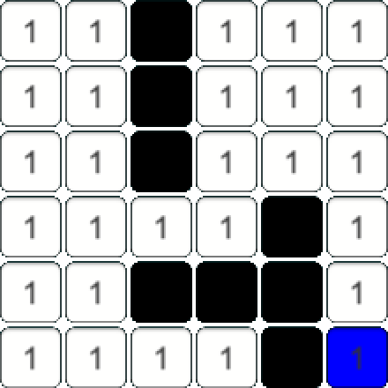

Background
The game labyrinth
Gridmap $M=ℕ^{n × m }$
Walls $M\left(i,j\right)=∞$
Set of exits $X_{goals}$
Notes:
Game Labyrinth
Field build up by fixed & moving tiles
Walls, passages and treasures on the tiles
Goal is to find ways through maze & collect treasures
To reach goal -> Way to calculate shortest paths
Dynamic Programming is one way to approach
Define a gridmap $M=ℕ^{n×m}$ as seen right
Value on tile == cost to step on it ~= distance
$M\left(i,j\right)=∞$ represent walls (black)
Set of goals player wants to reach

Slide 5
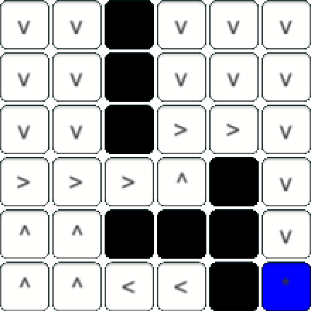


Problem Statement
Determine optimal policies
Function assigning the best possible action to every position in the maze
$P=N^{n×m}→A$
$$→$$
Notes:
Goal of paper is to determine optimal policies
A Policy is a function assigning best action to every position
$P=ℕ^{n×m}→A$
Therefore calculate value of all tiles, which equals shortest path length
Coming from left normal view
Determine actions
Show some examples…

Slide 6
Fundamentals of Dynamic Programming
Notes:
Continuing with the fundamentals used for approach
What is Dynamic Programming
The principle of Optimality which is important for DP
Fundamental approach for deriving mathematical formulations for this type of problem
Actual mathematical formulation
Which characteristics a problem solvable by DP

Slide 7

What is Dynamic Programming
Method used in mathematical optimization
Transforms complex problems into sequences of simpler subproblems
General framework for a broad variety of problems
Base concept: Sequential decision making problem
Tupel $\left\langle X,U,f,c,v,x_{init}\right\rangle$
Notes:
DP method in mathematical optimization & comp. Science
Transforms complex problems into sequence of simpler subp.
Each subproblem solved once & solution stored
If reoccuring, use cached result
Safe computation time
Recursively break down problem into these subproblems
Optimal solution by combing solutions for subproblems
General framework for many problem types
Planning of industrial Production lines
Scheduling patients ad medical clinic
Long term investment programs
Robot motion planning
Underlying sequence of decisions in finite number of stages
Timesteps, Moves…
Defined as Tupel $\left\langle X,U,f,c,v,x_{init}\right\rangle$
X: Set of states
U set of controls, transformations
$f:X×U↦X$ transition function, specifying next state if control u is executed in state x
$c:X×U↦ℝ$ cost function, remember number on tile
$v:X↦ℝ$ value function, shortest path length
$X_{init}∈X$ initial state

Slide 8
The principle of optimality
A policy is a sequence of decisions
An optimal policy is a sequence of decisions that has the best outcome w.r.t. a predefined criterion
Principle of Optimality
An optimal policy has the property, that whatever the initial state and initial decisions are, the remaining decisions must constitute an optimal policy with regard to the state resulting from the first decisions.
Notes:
For starting more precise discussion
A policy is a sequence of decisions.
An optimal policy is a sequence of decisions that has the best outcome w.r.t. a predefined criterion.
Classical approach would be, calculate all policies, and optimize the return
Not practical due to curse of dimensions
Low number of stages and choices explode
Richard Bellman, inventor of DP saw
No need to know whole sequence
Better find a general description, function that returns best decision at any time
Only depending on current state
Rewrote definition of optimal policy
An optimal policy has the property, that whatever the initial state and initial decisions are, the remaining decisions must constitute an optimal policy with regard to the state resulting from the first decisions.
Means that in which state we start and what decision we choose
Every decision that will later be done will hold the optimal policy

Slide 9

Mathematical formulation
$p=\left(p_{1},p_{2}, …,p_{M}\right)∈X$
$U=\left\{T_{k}\right\}; p∈X⇒T_{K}\left(p\right)∈X, ∀k$
$P=\left(T_{1}, T_{2}, …, T_{N}\right)$
$p_{1}=T_{1}\left(p\right)$
$p_{2}=T_{2}\left(p_{1}\right)$
$⋮$
$p_{N}=T_{N}(p_{N−1})$
$h_{N}\left(p\right)=\max_{p}{R(p_{N})}$
$h_{N}\left(p\right)=\max_{k}{h_{N−1}(T_{K}\left(p\right))}, N=2,3,…$
Notes:
How do the functional equations needed for DP
Process of system is describet at any time by M-dimensional vector:
$p=\left(p_{1},p_{2}, …,p_{M}\right)∈X$
Set of transformations
$U=\left\{T_{k}\right\};$
With property: $p∈X⇒T_{K}\left(p\right)∈X, ∀k$
Now having a N-stage process, a policy consists of a selection of N transformations:
$P=\left(T_{1}, T_{2}, …, T_{N}\right)$
$p_{1}=T_{1}\left(p\right)$
$p_{2}=T_{2}\left(p_{1}\right)$
$⋮$
$p_{N}=T_{N}(p_{N−1})$
What the goal is now is to maximize the return of the final stage
A return gives a scalar value for the final stage
For finding the optimal policy, we want to maximize this return
$h_{N}\left(p\right)=\max_{p}{R(p_{N})}$
Now using the principle of optimality
1. decision -> Transformation $T_{k}$
Result $T_{k}(p)$ -> left (N-1) stages -> Return $h_{\left(N−1\right)}\left(T_{k}\left(p\right)\right)$
To maximize the value, we want t want the maximum value of this equation
$h_{N}\left(p\right)=\max_{k}{h_{N−1}(T_{K}\left(p\right))}, N=2,3,…$
Recursively calculating From stage N till 0

Slide 10
Characteristics of problems solvable by Dynamic Programming
Fundamentals of dynamic programming

Slide 11
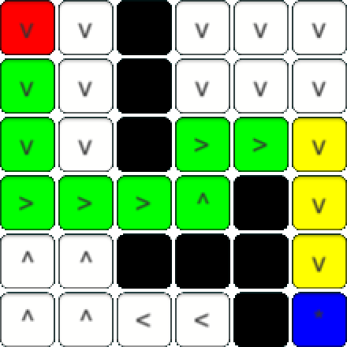
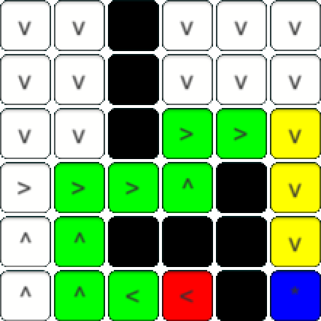
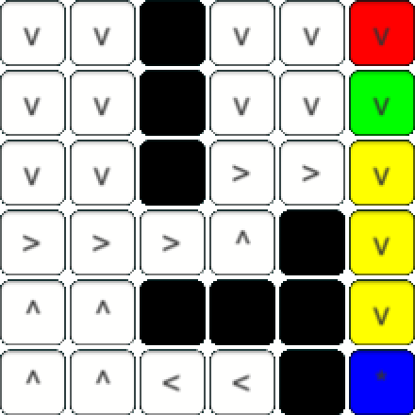
Overlapping Subproblems

Slide 12
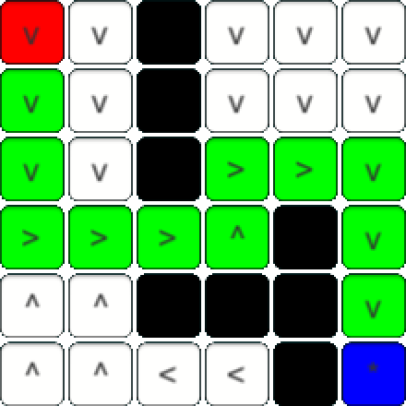
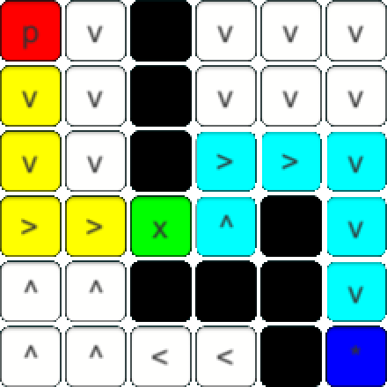
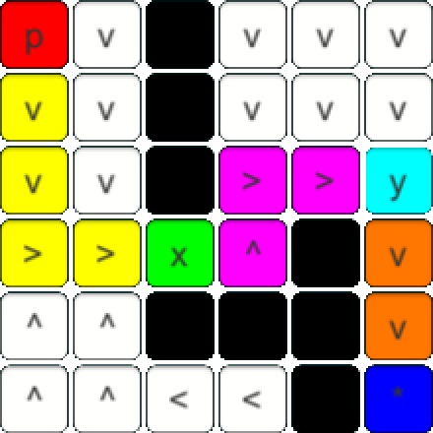
Optimal Substructure

Slide 13
How to apply Dynamic Programming in Computer Science
Fundamentals of dynamic programming

Slide 14

Memoization
Result of overlapping subproblems
Break down into small set of subproblems
Store results in a table
Use cached results if problem reoccuring
Computation time $⟷$ Memory usage

Slide 15

Bellman equation
Objective function defining desired outcome
State of system is tracked
Controls affect current state → Transformations
Value function giving best possible value of objective function
Backwards induction as direct outcome of Bellman equation
$V\left(x_{0}\right)=\max_{a_{0}}{ \{F\left(x_{0},a_{0}\right)+V\left(x_{1}\right)\}}$
$V\left(x_{0}\right)=\max_{a∈Γ(x)}{ \{F\left(x,a\right)+V(T(x,a))\}}$

Slide 16
Solving the Dynamic Programming equations

Slide 17

Finding the value function
Gridmap $M=ℕ^{n × m }$
Walls $M\left(i,j\right)=∞$
Optimal policies $P=ℕ^{n × m}→A$
Goal is to find value function $v\left(i,j\right)∈ℕ$
Cost function $c\left(i,j\right)=\left\{\begin{aligned}∞, if \left(i,j\right)∈ℝ^{2}\backslash \left\{n×m\right\} \\ M\left(i,j\right) else\end{aligned}\right.$
Trivial cases $v\left(i,j\right)=\left\{\begin{aligned}∞, if c\left(i,j\right)=∞ \\ 0, if \left(i,j\right)∈X_{goal}\end{aligned}\right.$

Slide 18

Finding the value function
Backwards iteration: $(N, N−1,…,0)$
Store results in memoization table $V=ℕ^{n×m}$
$v\left(i−1,j\right)=v\left(i,j\right)+c\left(i,j\right) if v\left(i−1,j\right)<V(i,j)$
$v\left(i+1,j\right)=v\left(i,j\right)+c\left(i,j\right) if v\left(i−1,j\right)<V(i,j)$
$v\left(i,j−1\right)=v\left(i,j\right)+c\left(i,j\right) if v\left(i−1,j\right)<V(i,j)$
$v\left(i,j+1\right)=v\left(i,j\right)+c\left(i,j\right) if v\left(i−1,j\right)<V(i,j)$

Slide 19



Finding the value function
Stage $N$
$v\left(3,4\right)=0$
Stage $N−1$
$v\left(3,3\right)=v\left(3,4\right)+c\left(3,4\right)=0+1=1$
$v\left(3,3\right)=v\left(3,4\right)+c\left(3,4\right)=0+1=1$
$v\left(3,3\right)=v\left(3,4\right)+c\left(3,4\right)=0+1=1$
$v\left(3,3\right)=v\left(3,4\right)+c\left(3,4\right)=0+1=1$
Stage $N−2$ (exemplary)
$v\left(2,3\right)=v\left(2,4\right)+c\left(2,4\right)=1+1=2$
$v\left(3,4\right)=v\left(2,4\right)+c\left(2,4\right)=1+1=2$
$v\left(2,5\right)=v\left(2,4\right)+c\left(2,4\right)=1+1=2$
$v(1,4)=v\left(2,4\right)+c\left(2,4\right)=1+1=2$

Slide 20

Recursive value function
$v\left(i,j\right)= \left\{\begin{aligned}∞, if c\left(i,j\right)=∞ \\ 0, if \left(i,j\right)∈X_{goal} \\ \min_{(x,y)}{\{v\left(x,y\right)+c(x,y)\}} else\end{aligned}\right.$
With $\left(x,y\right)∈\{\left(i+1,j\right),\left(i−1,j\right),\left(i,j+1\right),\left(i,j−1\right)\}$

Slide 21

Finding optimal policies
Memoization table $V$ holding the values of all tiles
Find shortest paths $⟺$ Follow decision sequence with lowest sum of values
$a\left(i,j\right)=\left\{\begin{aligned}up, if v\left(i,j−1\right)=\min_{(x,y)}{\{v\left(x,y\right)+c(x,y)\}} \\ right, if v\left(i+1,j\right)=\min_{(x,y)}{\{v\left(x,y\right)+c(x,y)\}} \\ down, if v\left(i,j+1\right)=\min_{(x,y)}{\{v\left(x,y\right)+c(x,y)\}} \\ left, if v\left(i−1,j\right)=\min_{(x,y)}{\{v\left(x,y\right)+c(x,y)\}}\end{aligned}\right.$
With $\left(x,y\right)∈\{\left(i+1,j\right),\left(i−1,j\right),\left(i,j+1\right),\left(i,j−1\right)\}$

Slide 22
Related work and use cases in robot motion planning

Slide 23
Autonomous vehicles
Cars etc. are just one type of robots
Many research in last years
Solving navigation with Dynamic Programming, best action for every position is calculated
Also applicable for vacuum robots…

Slide 24
Extending the 2-dimensional algorithms onto N-dimensional problems
Define a state as a node in a graph
Define the transitions between states as edges in the graph
Apply 2-dimensional algorithm onto graph to solve N-dimensional problem
But curse of dimensions

Slide 25

Spacecrafts floating in $ℝ^{3}$
Approaches are made on spacecrafts
One example by LaValle is one having 3 thrusters
Underactuated system solved by Dynamic Programming

Slide 26
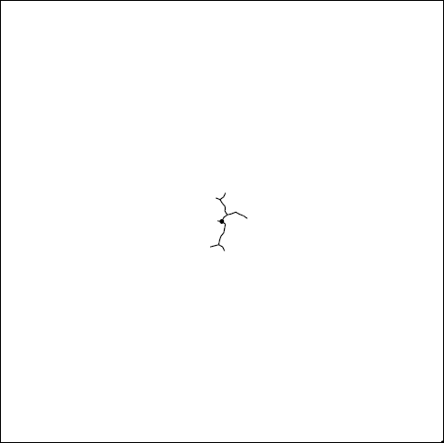
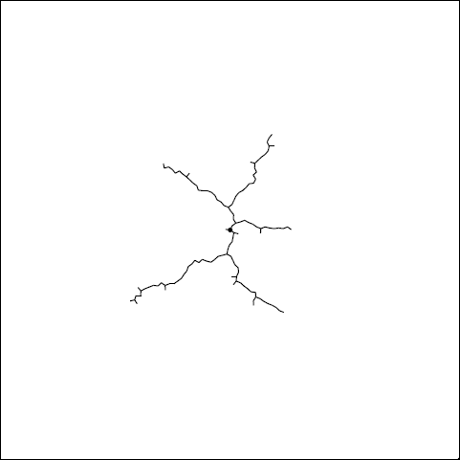
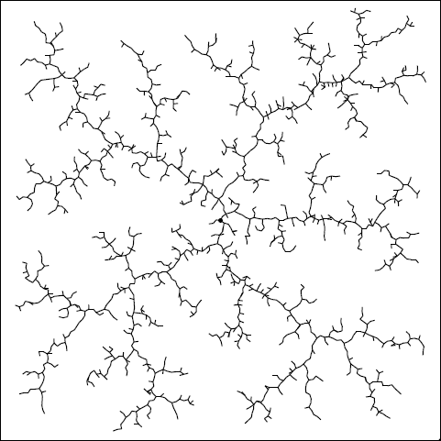
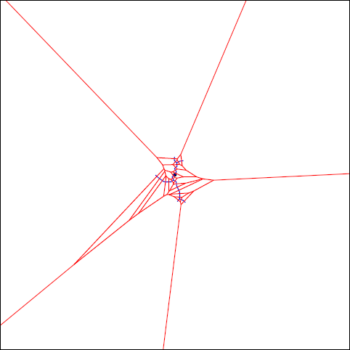
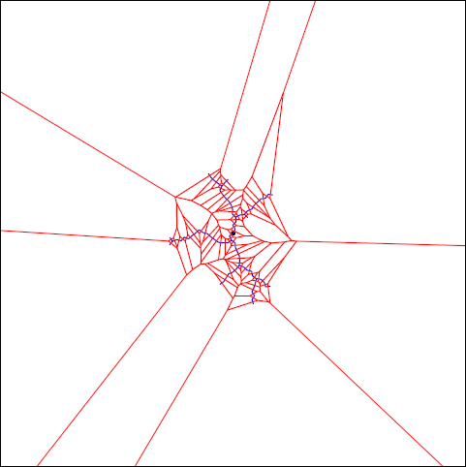
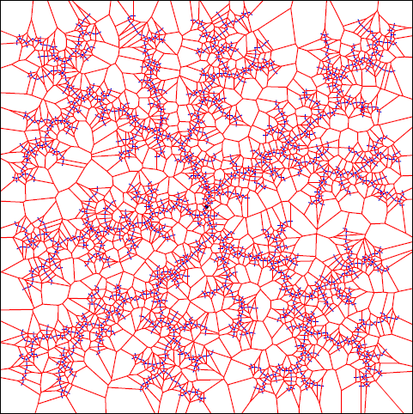
Rapidly exploring random trees Original

Slide 27
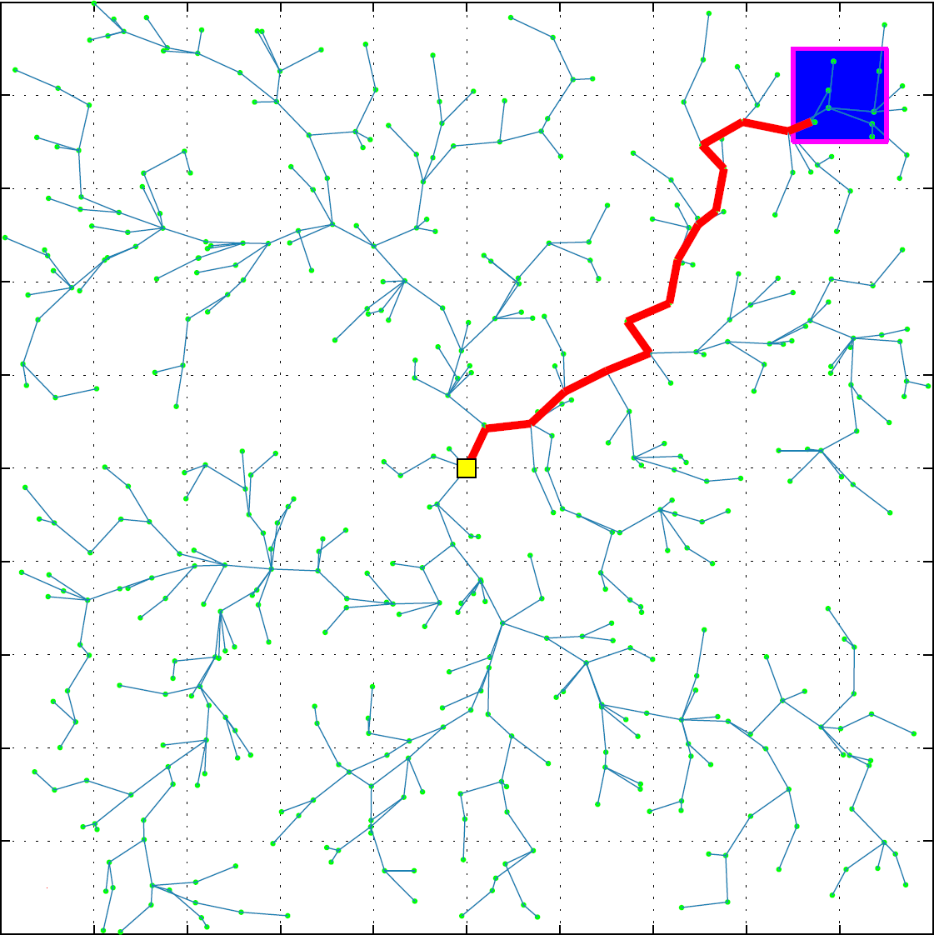
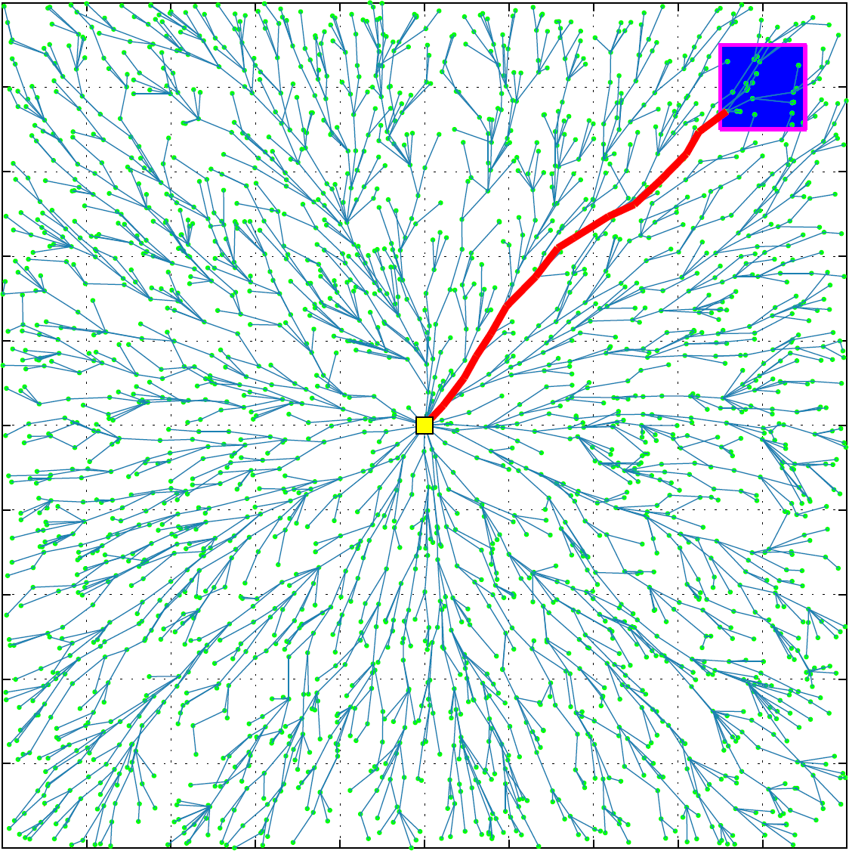
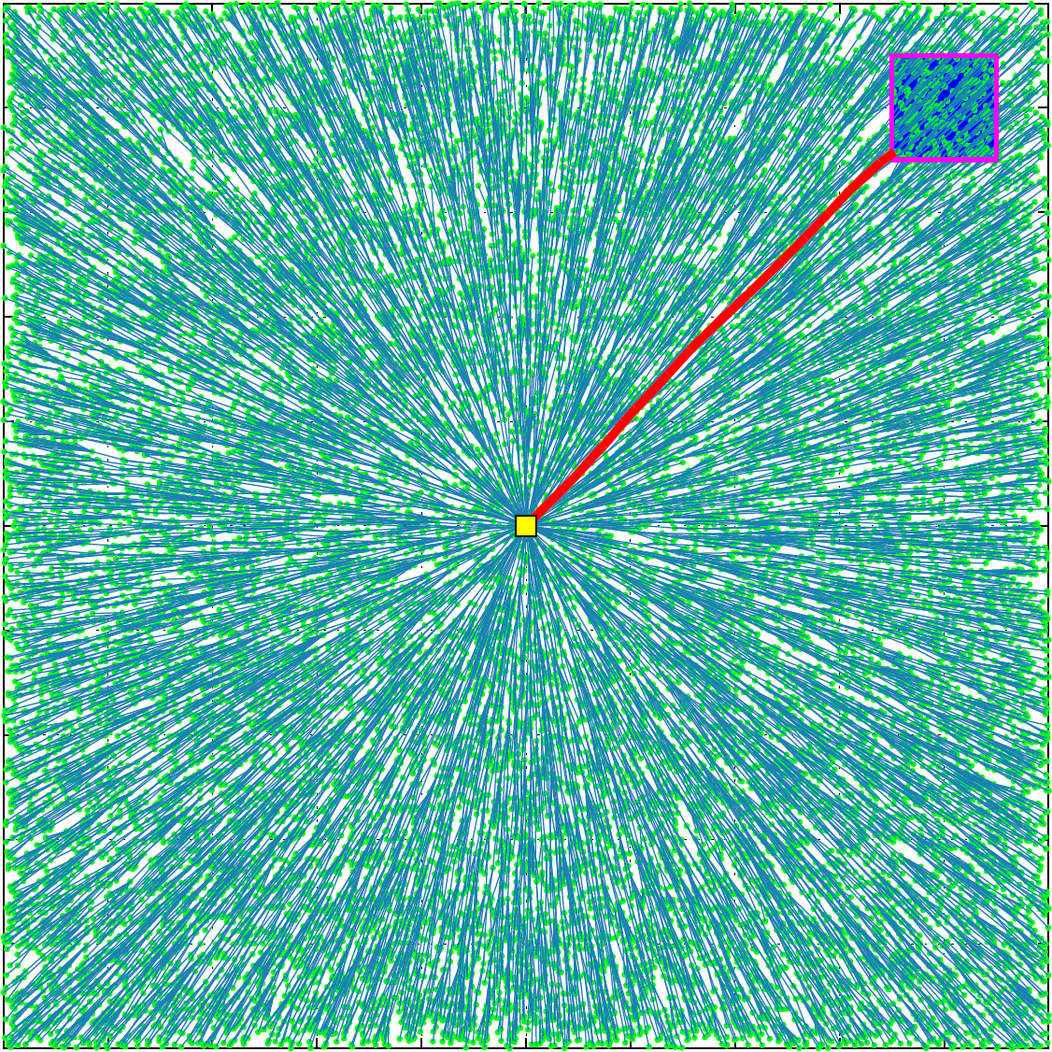
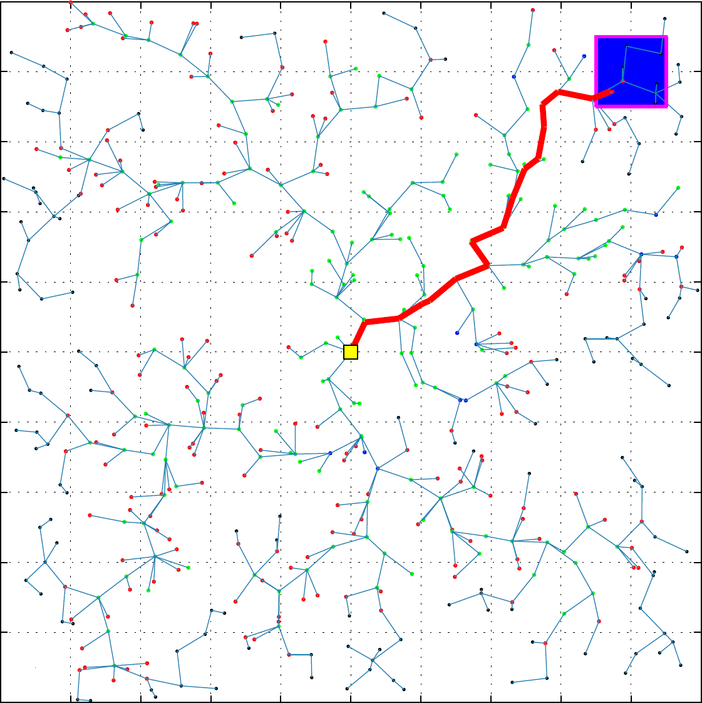
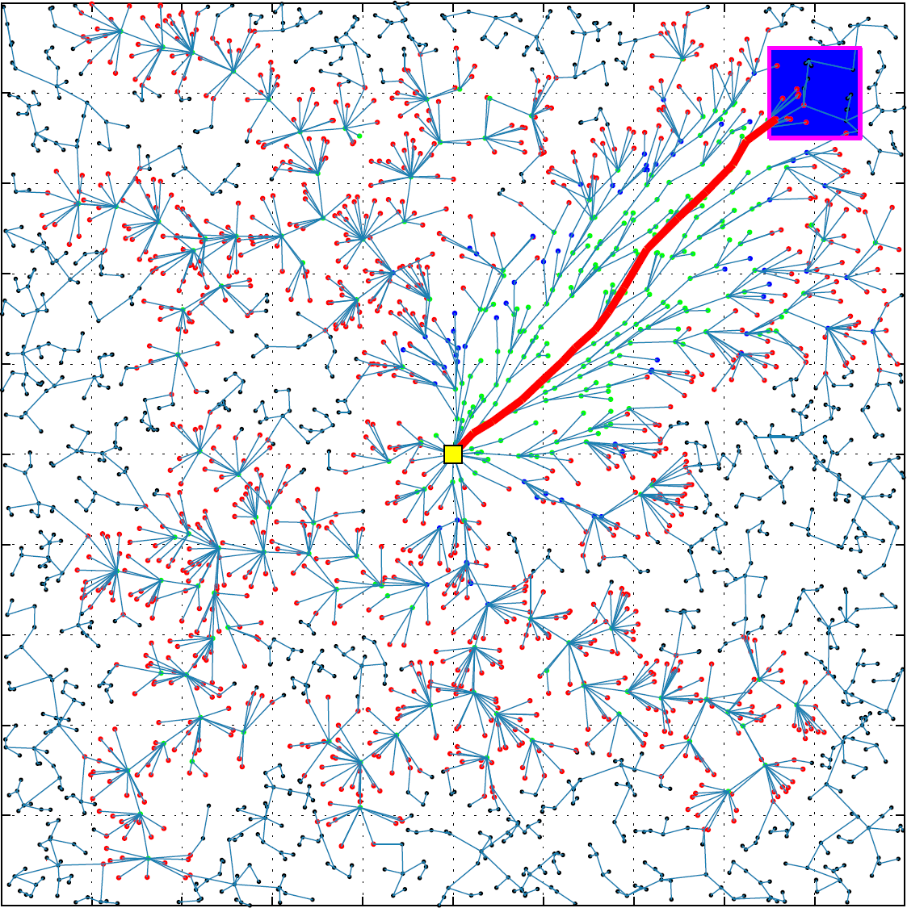
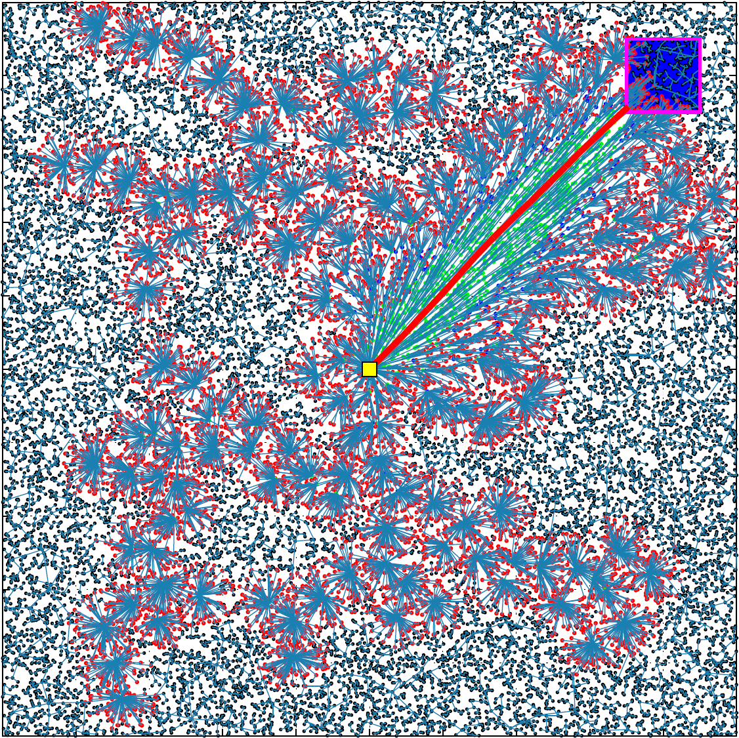
Rapidly exploring random trees Dynamic Programming

Slide 28
Conclusion

Slide 29
Thank you!

